Slide 1
Stereo Simulation in 3D Space
洪暐智B96901036, 蕭文翔B96901085, 周彥丞B96901136
{b96901036, b99601085, b96901136}@ntu.edu.tw

Slide 2

Stereo Simulation in 3D Space
R
S

Slide 3
Project Goals
Single moving receiver
Rectangular decomposition
Interface handler
3D FDTD
2D Frequency domain simulator
Real-time speed
3D Frequency domain simulator

Slide 4
Project Goals (Differences)
The implement detail of Frequency domain is not fully revealed in the reference paper
We thought that the “DCT” in the paper is not the conventional “DCT” in digital image processing
3D Frequency domain simulator
DCT only be fast enough under FFT-based algorithm
Too hard to handle the 3D-DCT

Slide 5

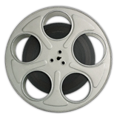
Current Status
C version
GPU version
Single moving receiver
Rectangular decomposition
Interface handler
3D FDTD
2D Frequency domain simulator
Real-time propagation with precomputed wave simulation
Single moving receiver
Rectangular decomposition
Interface handler
3D FDTD
2D Frequency domain simulator
Real-time propagation with precomputed wave simulation
!
Matlab

Slide 6

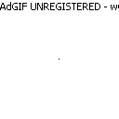
Current Status
Demo
Audio Output: in a rectangular room
Wave front propagation:
DCT (Fs = 1600Hz)
FDTD (Fs = 44100Hz)
Original
Simulated
Original
Simulated

Slide 7
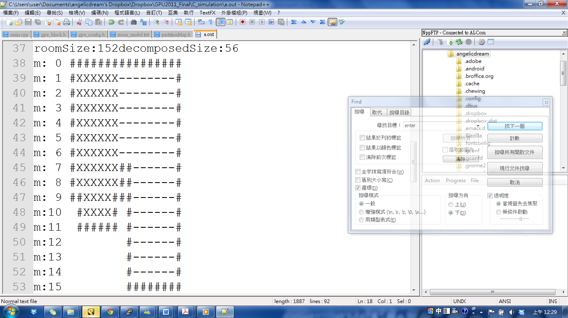
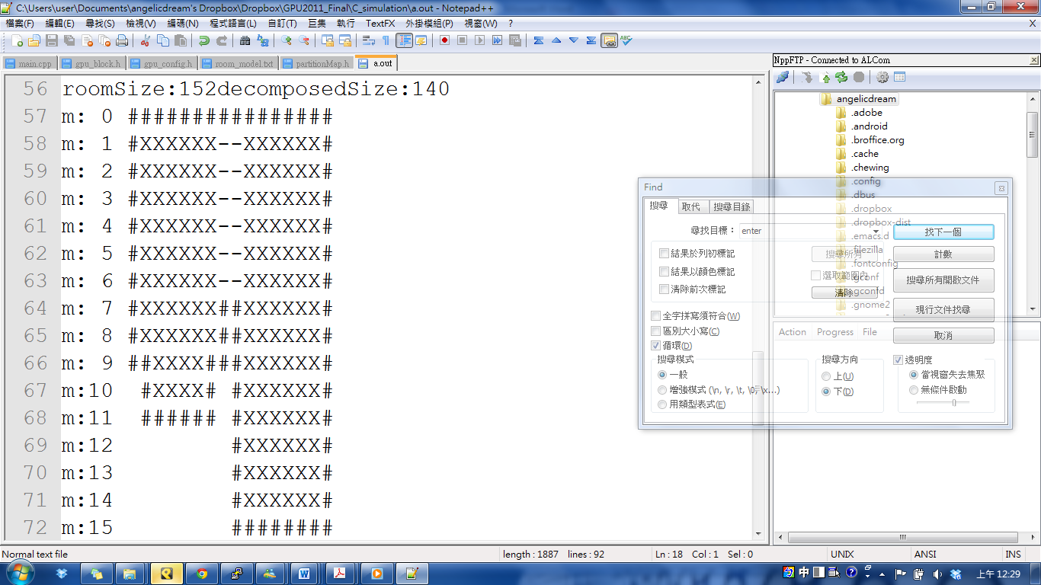

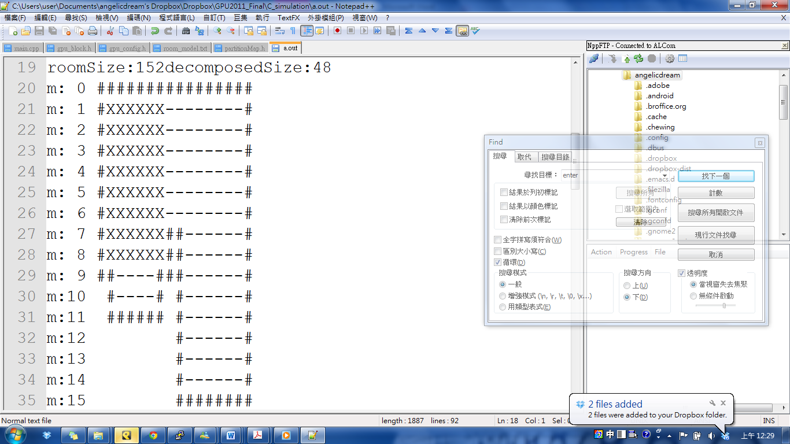
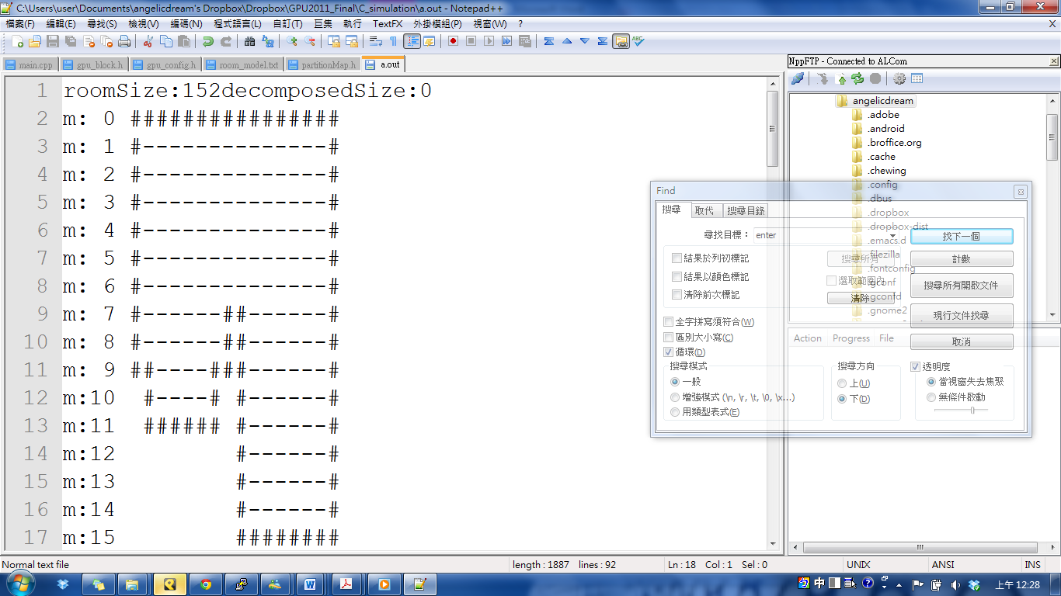
Current Status
Demo
Rectangular decomposition

